Slide 1

IBOX-DEKSTOP ASSITANT
School of Computer Science and Engineering
Department of Computer Science and Engineering
Submitted By: TANAY ANAND
23FE10CSEOO476
Supervised By: PROF.BALI DEVI

Slide 2
Outline
Introduction
Literature Review
Problem Statement
Proposed Solution
Objectives
Results

Slide 4
1. Introduction
With the rapid advancement of technology, human-computer interaction has shifted toward more natural and intuitive methods. Voice-based systems (also known as voice assistants) aim to enable users to interact with machines using spoken language instead of traditional input methods like keyboards or touchscreens. Despite their growing popularity, several challenges still hinder their efficiency, accuracy, and usability.
Voice assistants are now widely used in smartphones, smart homes, automobiles, and customer service systems, making them an integral part of modern digital life. These systems rely on technologies such as speech recognition, natural language processing, and artificial intelligence to interpret and respond to user commands. The demand for hands-free and faster interaction has further accelerated their adoption across various domains.
However, variations in human speech patterns, including differences in accent, tone, language, and pronunciation, create significant challenges for these systems. Background noise and environmental disturbances also affect the performance of voice recognition systems. Additionally, understanding the context and intent behind user commands remains a complex task.
As a result, there is a growing need to develop more advanced and reliable voice-based systems that can overcome these limitations and provide seamless, accurate, and efficient user interaction.

Slide 5
Literature Review
Voice-based assistant systems have gained significant attention in recent years due to advancements in artificial intelligence, speech recognition, and natural language processing. Modern voice assistants such as Siri, Alexa, and Google Assistant have transformed human-computer interaction by enabling users to perform tasks through voice commands instead of traditional input devices.
Early research in this field focused on developing basic speech recognition systems that could understand a limited set of commands. Over time, these systems evolved into intelligent personal assistants (IPAs) capable of handling complex queries, contextual conversations, and multiple tasks. These systems combine technologies such as Automatic Speech Recognition (ASR), Natural Language Processing (NLP), and speech synthesis to provide meaningful responses.
Automatic Speech Recognition (ASR) plays a crucial role in voice assistants, as it converts spoken language into text. ASR systems use techniques from digital signal processing, machine learning, and linguistics to recognize speech accurately. Recent studies show that ASR has improved significantly and is widely used in applications such as education, healthcare, and robotics.

Slide 6
Problem Statement
The development of a voice-based assistant system aims to provide a seamless and efficient way for users to interact with machines using natural speech. However, designing such a system presents several technical and practical challenges that affect its overall performance and user experience.
One of the major problems is the accuracy of speech recognition, as voice assistants often struggle to correctly interpret spoken words due to variations in accent, pronunciation, speech speed, and language differences. Background noise and environmental disturbances further degrade the system’s ability to capture and process user input effectively.
Another significant issue lies in understanding the intent and context of user commands. Voice-based systems may fail to interpret complex queries, ambiguous instructions, or conversational language, leading to incorrect or irrelevant responses. This limitation reduces the reliability and usefulness of the system in real-world applications.
Additionally, delays in processing and response generation can negatively impact user experience, especially in real-time applications. Some systems also depend heavily on internet connectivity, making them less effective in offline or low-network conditions. Integration with multiple applications and handling multiple commands simultaneously also remain challenging tasks.

Slide 7
Solution
The challenges associated with the development of a voice-based assistant system can be effectively addressed through the use of advanced technologies and optimized system design. One of the primary issues, speech recognition accuracy, can be improved by integrating robust speech recognition engines such as Google Speech Recognition and DeepSpeech. These systems are trained on large and diverse datasets, allowing them to better understand different accents, pronunciations, and speech patterns. Additionally, implementing noise reduction techniques and using high-quality microphones can significantly minimize the impact of background disturbances, thereby enhancing input accuracy.
Another critical challenge is understanding user intent and context. This can be resolved by incorporating advanced Natural Language Processing techniques. NLP enables the system to process and interpret human language more effectively. Libraries such as spaCy and NLTK can be used to implement intent recognition, entity extraction, and contextual understanding. By doing so, the assistant becomes capable of handling complex queries and conversational inputs, thereby improving its reliability and usefulness.
To address delays in processing and response generation, optimization techniques can be applied to the system. The use of multi-threading allows different processes, such as listening and responding, to run simultaneously, reducing waiting time. Furthermore, frequently used commands can be cached, and certain operations can be performed locally instead of relying entirely on cloud services, which helps in improving response speed.

Slide 8
Objective
The main objective of developing the voice-based assistant system is to create an intelligent and user-friendly platform that enables seamless interaction between humans and machines using natural speech. The system aims to eliminate the need for traditional input devices such as keyboards and mice by allowing users to perform various tasks through voice commands, thereby enhancing convenience and accessibility.
Another important objective is to design a system that can accurately recognize and interpret spoken language. By integrating speech recognition technologies such as Google Speech Recognition and applying Natural Language Processing techniques, the assistant is intended to understand user commands effectively and provide appropriate responses. This improves the overall efficiency and usability of the system.
The project also aims to automate routine tasks such as opening applications, searching information, telling time, and accessing web services. By doing so, it reduces manual effort and saves time, making daily interactions with computers more efficient. Additionally, the system focuses on providing real-time responses with minimal delay to ensure a smooth user experience

Slide 9
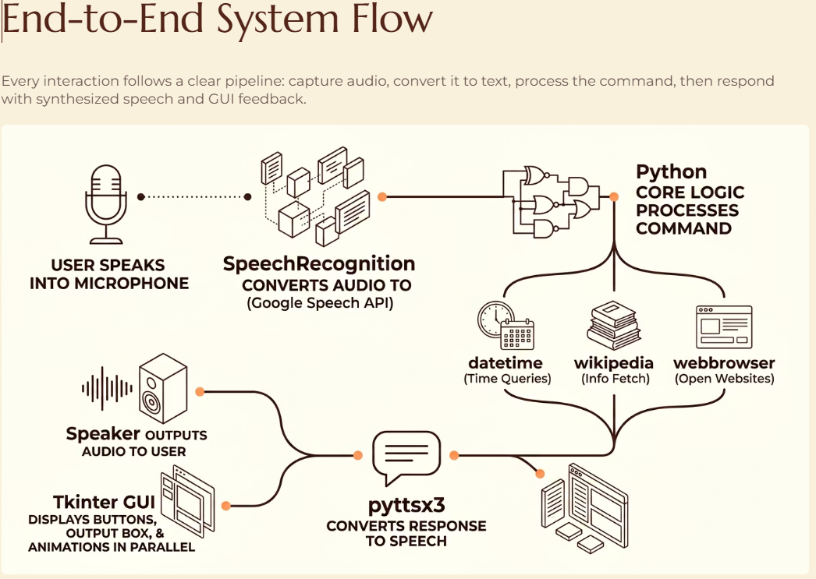
Proposed Methodology

Slide 10
References
P. Darda and R. M. Chitnis, “Voice Assistant: A Systematic Literature Review,” Shodh Sarita Journal, vol. 7, no. 27, pp. 67–72, 2020.
S. Alharbi et al., “Automatic Speech Recognition: Systematic Literature Review,” IEEE Access, 2021.
A. Neupane, “Literature Survey on Natural Language Processing in Voice Assistants,” IJRASET, 2023.
J. Santos et al., “Intelligent Personal Assistants: A Systematic Literature Review,” Expert Systems with Applications, vol. 147, 2020.

Slide 11
THANK YOU

